Slide 1
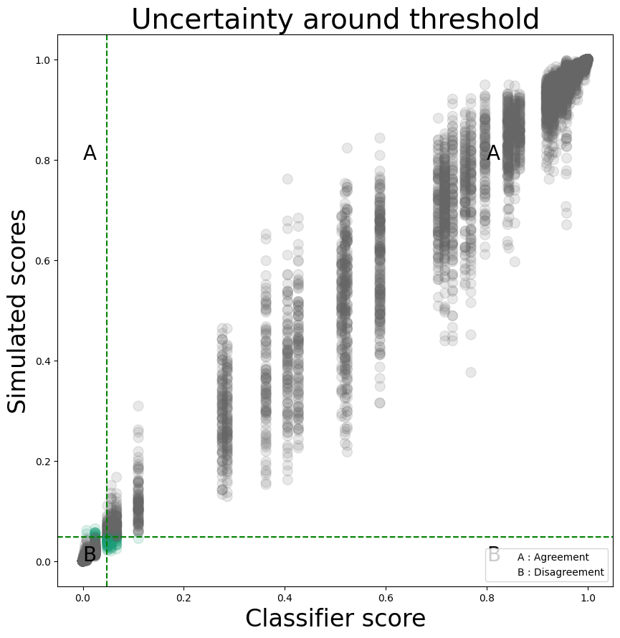
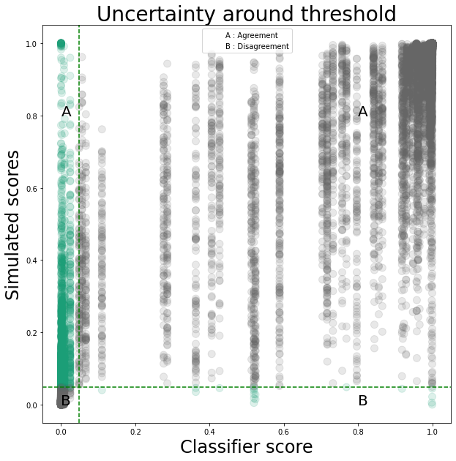
Without gene-specific RSD
With gene-specific RSD

Slide 2
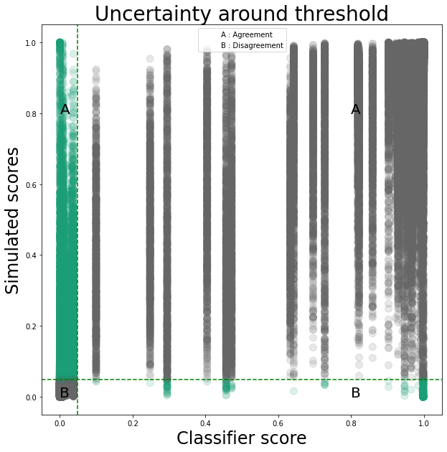
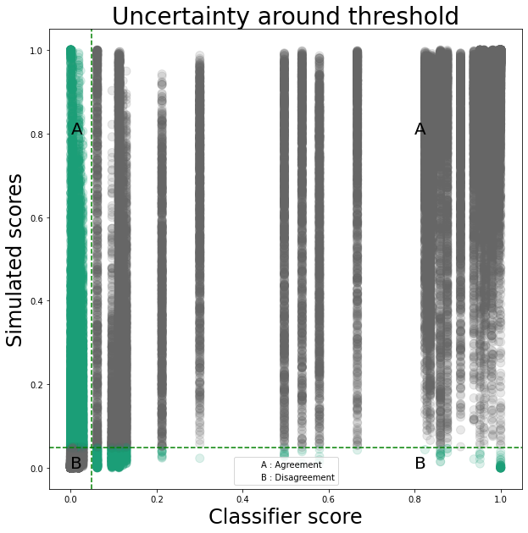
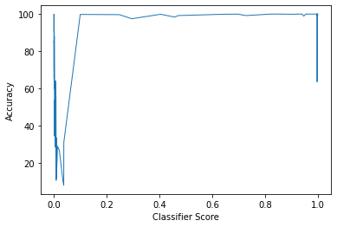
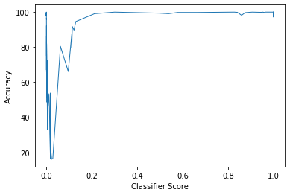
R1 simulations
R2 simulations
 | R1 Values | R2 Values
No. of subjects | 243 | 95
simulations in agreement with subject | 225667 | 78248
simulations in disagreement with subject | 17333 | 16752
Unreliable Subjects | 138.0 | 64.0
% Unreliable subjects | 56.8% | 67.4%
specificity | 0.93 | 0.8
sensitivity | 0.88 | 0.91

Slide 3
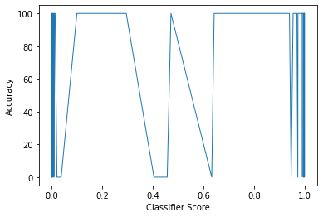
V-plot with true labels of subjects and the accuracies of their simulations

